Slide 1


Slide 2

30 Days Python Master Class
Day1 : Python
Time: 6.00 PM IST
Free Registration

Slide 3
Python Master Class
Handbook

Slide 4
NANDHINI.S
Exp: 5 Yrs
Expert in
Python Developer on Machine Learning
Deep learning with computer vision
Matlab – Image Processing
Autonomous Car design using ROS with LIDAR
Language – Python , Java , HTML ,CSS.
Tools – ANACONDA NAVIGATOR, JUPYTER NOTEBOOK,
GOOGLE COLAB.
Graduation : BE – ECE | 2011

Slide 5
Pantech?
Educational Equipment Manufacturer
IoT, AI, Robotics,Autonomous Robot
Microprocessor/Microcontroller
DSP,VLSI, Embedded System
Power Electronics & Drives, Fuel Cell Trainer Kit
Renewable Energy Lab, Electric Vehicle Lab
Technical Training
DIY Project

Slide 6

What is Master Class ?
👍 This is the 30 Days Industrial Learning Activity.
👍 Its Online YouTube Live Class
👍 If you Invest 45 minutes daily, U will become Master in Data Science
👍 You will get FREE E-Certificate
Webinar Participation Certificate
“Learning is the beginning of wealth.
Searching & Learning is where the miracle process all begins.” …………….Jim Rohn

Slide 7
Our Vision
Help 10 Million Students to Learn the Technology in Easy Way

Slide 8

Associate Partner for this Master Class
https://apssdc.in/home/

Slide 9
What U will Learn from 30 Days Data Science & Analytics Master Class

Slide 10





Python Learning Plan
01
02
03
04
05
Library
Python
Analytics
Analytics
Industry Project
Introduction To Python and Python Data Structures
Pandas
Numpy
MatplotLib
Cborn, SKLearn Lib
Collab
Distribution
Visualization
Aggregation
Statistics
Distribution Function
Project Building

Slide 11
Day wise Learning Plan
Day -1 : Introduction to Python
Day -2: Python – Tools|Syntaxes & Data Structures
Day -3: Python – Dictionaries,Date and Time
Day -4: Python – MySql
Day -5: Pandas library – Introduction
Day -6: Pandas library – Data Structures
Day -7: Numpy library – Introduction
Day -8: Numpy library – Array Manipulations, Mathematical Functions
Day -9: Matplotlib , Histogram Using Matplotlib | I/O With Numpy
Day -10: Matplotlib Library - Introduction , Pyplot API | Types Of Plots
Day -11: Seaborn Library
Day -12: SKLearn Library
Day -13: Python – Date and Time , Data Wrangling.
Day -14: Python – Data Cleansing
Day -15: Python – Word Tokenization , Stemming and Lammetization.

Slide 12
Day wise Learning Plan
Day -16: Python – Data Visualization
Day -17: Python – Statistical Analysis
Day -18: Python – Types Of Distribution
Day -19: Python – Correlation ,Chi-Square Test , Linear Regression
Day -20: Keras library – Introduction.
Day -21: Stock Price Prediction With Machine Learning LSTM RNN
Day -22: People’s behaviour in chat message using NLP NLP
Day -23: Gaming In Python
Day -24: Chatbot creation in Python NLP
Day -25: Electricity Price Prediction Using ML Random Forest Regressor
Day -26: Diamond Price Prediction Using Python Linear Regression
Day -27: Book Recommendation System KNN
Day -28: Image Classification Using CNN CNN
Day -29: Titanic Survival Analysis Using ML Logistic Regression
Day -30: Blockchain in Python

Slide 13
List of Projects for Demo in YouTube Live
Stock Price Prediction With Machine Learning
People’s behaviour in chat message using NLP
Gaming In Python
Chatbot creation in Python
Electricity Price Prediction Using ML
Diamond Price Prediction Using Python
Book Recommendation System
Image Classification Using CNN
Titanic Survival Analysis Using ML
Blockchain in Python
All Projects in Jupyter Notebook

Slide 14
What you will get from this Free 30 Days Master Class?
You can attend YouTube Live Class
Free E-Certificate ( WEBINAR PARTICIPATION CERTIFICATE)

Slide 15
How to mark your Attendance in YouTube Live Class?
Ans : During the Live Class, organizer will post Google Form link in Live Chat. The Participants should submit the from on daily basis. Minimum 25 Days Attendance is Required to get Free Master Class Participation Certificate.
Note : The Link will be available during the Live. From the LIVE Class date, the live video will get removed from the YouTube in 3 days.

Slide 16


Sample Webinar Participation Certificate?

Slide 17
https://www.pantechelearning.com/data-science-master-class/
On Demand
You can get chance to apply 1 Month Internship on Data Science & Analytics Master Class

Slide 18
What is Internship????
Learn
Practice
Verify
Get Certified
Grow

Slide 19
Free Master Class DSA | 1 Month Internship on DSA
Master Class Participation Certificate | Internship Completion Certificate
Minimum 25 Class should attend YouTube Live | Recorded Class Link will be provided. – LMS Portal Access
YouTube Live Mandatory | Your Choice. You can attend Live or else You can watch Recorded Class in LMS Portal
All Projects Demo class in YouTube Live | Step by Step Video Explanation Content in LMS Portal
Access : 3 Days | VIP WhatsApp Group Support
 | You Can Download All PPTs
 | 4 Nos of Hackathon Class in Zoom Live. The Recording also will be provided
 | You Can Download All Project Files
 | Mentor will guide you to finish 10 Projects
 | Access : 60 Days

Slide 20
Pantech will make you to Create 10 Projects in Data Science & Analytics in 30 Days
Objective of this 30 Days Master Class

Slide 21
1 Month Internship in Data Science
INTERNSHIP E-Certificate(30Days Internship on Data Science Engineering)
Highly organized Video content
Download All Files
Download PPTs
Assignments
Flexible Time.
Access Period: 60Days from the date of payment

Slide 22
What You Will Get???
Complete Project Files
30 Days Learning Activity
Data Science Core Concepts
10 + Projects
Project PPT
Spatial Data Science For Covid-19 Disease Prediction
Parkinson’s Disease Prediction-XGBoost Classifier
House Price Prediction-Random Forest Regression
Customer Segmentation Using ML-K-Means Clustering
Home Loan Prediction-Decision Tree Classifier
Spam Classification-NLP
Hand Written Digit Recognition Using Python-CNN
Churn Prediction-Deep Learning
Crop Yield Prediction
Ground water level prediction
Video Class Access for 2 Months
Get chance to Enroll 1-Month Internship on demand

Slide 23

How to join in 1 month Internship
https://www.pantechelearning.com/pymc-internship/
Coupon Code: PYMC

Slide 24
Linear Regression

Slide 25
Regression:
It is one of the most important statistical and machine learning tools.
It is defined as the parametric technique that allows us to take decisions based on data.
It allows us to make predictions based upon data by learning the relationship between input and output variables.
The output variable dependent on the input variables are continuous valued real numbers.
Regression help us to understand how the value of output variable changes with respect to the changes in the input variable.
Regression techniques are used for the prediction of prices , economics and variations.

Slide 26
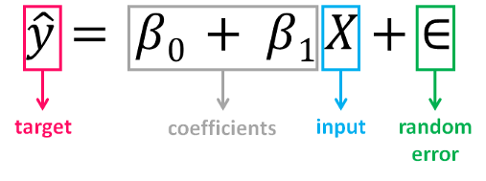
Simple Linear Regression:
It is the simplest form of linear regression used when there is one single input variable(input) for the output variable(target).
The input variable helps in predicting the value of the output variable.
It is referred to as X.
The output or target variable is the variable that we want to predict(y).

Slide 27
Simple Linear Regression:
ß0 , called the intercept , shows the point where the estimated regression line crosses the y-axis.
ß1 determines the slope of the estimated regression line.
Random error describes the random component of the linear component between independent and dependent variable.
The true regression model is usually never known.
The value of the random error term corresponding to observed data points remains unknown.
Regression model can be estimated by calculating the parameters of the model for an observed dataset.

Slide 28
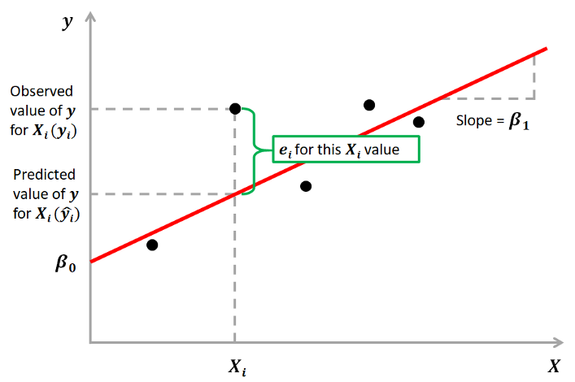
Simple Linear Regression:
The main aim of regression is to estimate the parameters ß0 and ß1 from the sample.
Once we find the optimum values for these two parameters , a line of best fit can be used to find the values of Y given the values of X.
Fit a line to find the relationship between input and output variables.
The line is used to predict the output of unseen inputs.

Slide 29
Simple Linear Regression:
ß0 and ß1 values are estimated using the Ordinary Least Squares(OLS).
The main goal is to minimize the distance from the black dots to the red line as close to zero as possible.
It is done by minimizing the squared distances between actual and predicted outcomes.
The difference between actual and predicted value is called the residual(e) .
It can be negative or positive depending on whether the model overpredicted or underpredicted the outcome.
To calculate the net error , adding all the residuals can lead to the cancellation of terms and reduction of net effect.

Slide 30
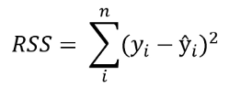
Simple Linear Regression:
To avoid this , take the sum of squares of error terms and it is called the residual sum of squares(RSS).

Slide 31
Simple Linear Regression:
The ordinary least squares method(OLS) method reduces the residual sum of squares(RSS) .
Its objective is to fit a regression line that would minimize the regression line from the observed values to the predicted values(the regression line).

Slide 32
Different Kinds Of Relationship:
Positive Relationship: When the regression line between two variables moves in the same direction with an upward slope , then the variables are said to be positively correlated.
If we increase the value of x(independent variable) , then we will see an increase in the dependent variable.
Negative Relationship: When the regression line between two variables moves in the same direction with a downward slope , then the variables are said to be in a negative relationship.
If we increase the value of independent variable(x) , we will see a decrease in the depenedent variable(y).

Slide 33
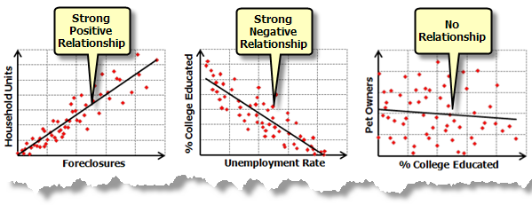
Different Kinds Of Relationship:
No Relationship: If the best fit line is flat , then we can say that there is no relationship between the variables.
The dependent variable won’t change by increasing or decreasing the independent variable.

Slide 34
Linear Regression Relationship:
Covariance: This paramter tell us the direction of relationship between x and y .
It doesn’t tell anything about how positive or negative a relationship is.
If the covariance value is negative , if the independent variable increases , then the dependent variable decreases.
Correlation: It is a statistical measure that tell us the direction of relationship as well as the strength of relationship.

Slide 35
Applications:
Predicting advertising expenses.
Medical diagnosis.
Agricultural research.

Slide 36
Advantages and Disadvantages:
It performs well for linearly separable data.
It is easier to implement , interpret and training can be done in a faster way.
Disadvantages:
The assumption of linearity between independent and dependent variables.
It is prone to noise and overfitting.

Slide 37
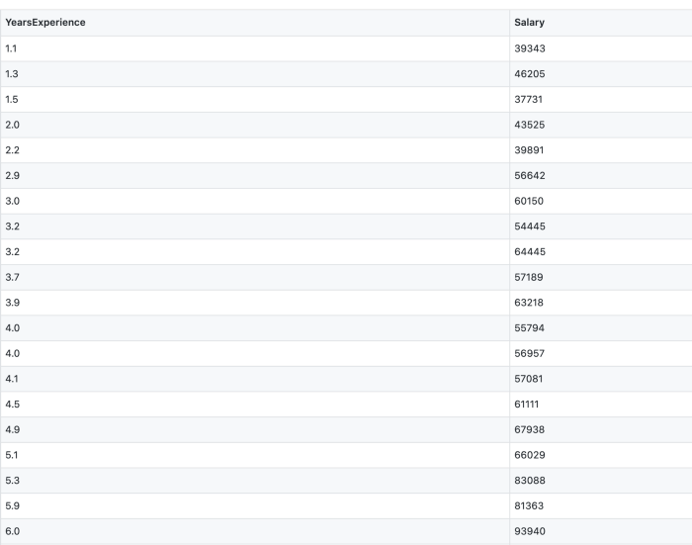
Regression:
A regression problem is one when the output variable is a continuous value , such as “salary” or “weight”.
Linear regression is a statistical method of finding the relationship between the independent and dependent variable.

Slide 38
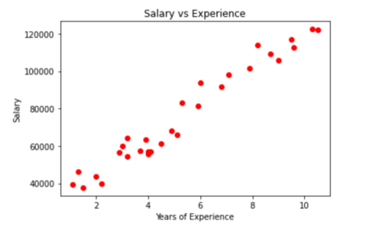
Regression:
This regression is a technique where the correct data is given and we need to find the correlation between the data.
In a regression problem , it always predicts a real value or continuous value as the input.
This example is used to predict the salary (dependent variable y) of a person based on the independent variable(x) are given.

Slide 39
Regression:
First , we need to find the independent variable(values which are used to predict the dependent variable) and dependent(value which is to be predicted) variable from the dataset .
We need to fit those variables in the linear regression cost function.
The cost function is used to measure the performance of the machine learning model for the given data.

Slide 40
Regression:
A regression plot is being plotted and when a new value comes in(year) , the salary of the person can be predicted with the help of regression model.
Only one independent variable is taken and it is also called as linear regression with one variable or univariate linear regression.

Slide 41
Cost Function Of Linear Regression:
The linear function equation is the cost function for this simple linear regression.
‘x’ is used to denote the input variable(years of experience) .
They are also called as input features.
y is used to denote the “output” or target variable .
y is nothing but the predictor variable(salary).
When the target variable we are trying to predict is continuous , the learning problem is called as a regression problem.

Slide 42
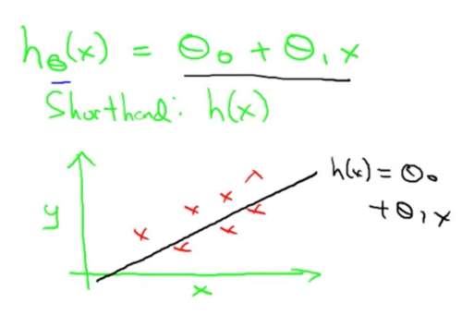
Cost Function Of Linear Regression:

Slide 43
Cost Function Of Linear Regression:
Theta 0 and theta 1 are the parameters of the model are the parameters of the model .
X is the independent variable.
Theta 0 and theta 1 values must be chosen such that h(x) is close to y.
Linear Regression algorithm aims to solve a minimization problem.
The difference between h(x) and y should be small.
Use the notation (x(i),y(i)) to denote the ith training example.
Sum over the training set , i=1 to m(training examples) , of the squared difference between them and this is the prediction of the hypothesis.

Slide 44
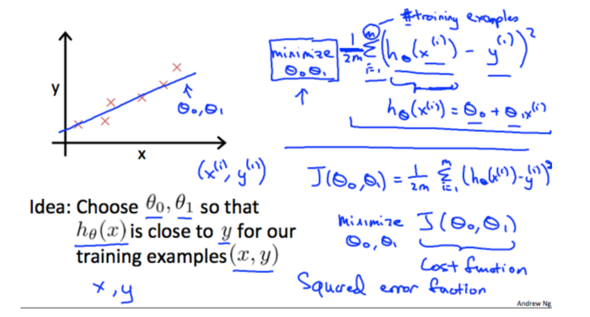
Cost Function Of Linear Regression:

Slide 45
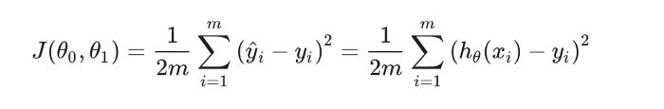
Cost Function Of Linear Regression:
The accuracy of the hypothesis function can be measured by using the cost function.
It takes an average difference of all the results of hypothesis with inputs from x’s and the actual outputs y’s.

Slide 46
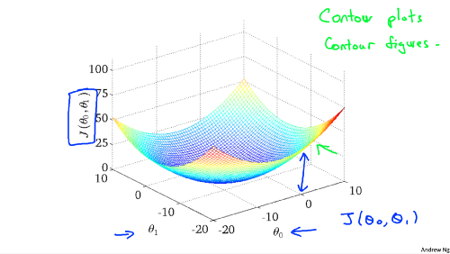
Cost Function Of Linear Regression:
To break it apart , it is 1/2x-,
X- is the mean of the squares of h(theta) (x{i})-y{i} .
It is nothing but the difference between the predicted value and the actual value.
This function is called as “Mean Squared Error”.
This is the cost function.

Slide 47
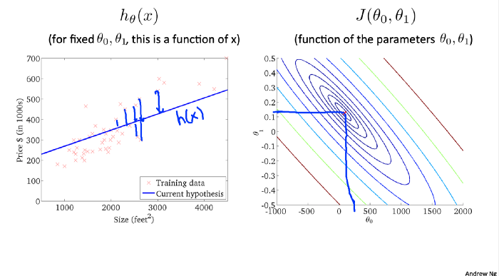
Cost Function Of Linear Regression:
First , assign some random values to theta0,theta1 and then find h(x).

Slide 48
Cost Function Of Linear Regression:
In the above plot , the curved graph is drawn flat.
The 3D drawing is plotted as 2D.
We have to find the min. Value of J(theta0,theta1) that is the small oval(global optimum).
From the contour plot , some method like OLS method is used to find the min of J(theta0,theta1)
The corresponding values of theta0 and theta1 is taken for h(x).
The regression line is plotted to that data and this is the cost function.

Slide 49
Ordinary Least Squares(OLS):
We need to find the best fit line to the dataset.
In order to find the best fit line , we need to use the OLS method:
Y = mx+b.
M – slope,
X – independent variable.
B – intercept.
OLS method is used to find the best line intercept:

Slide 50
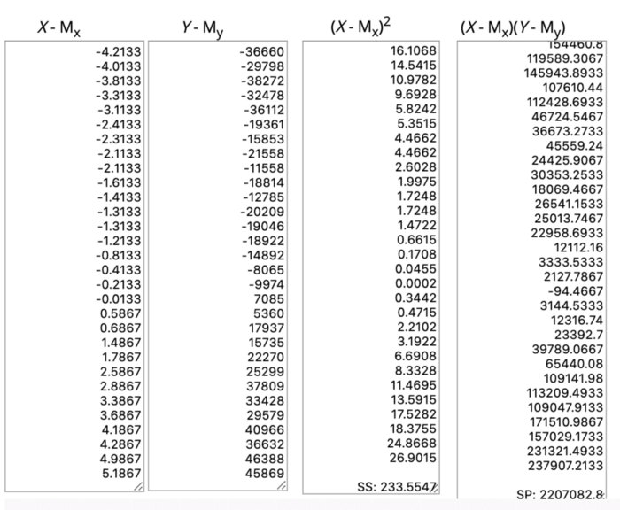
Ordinary Least Squares(OLS):

Slide 51
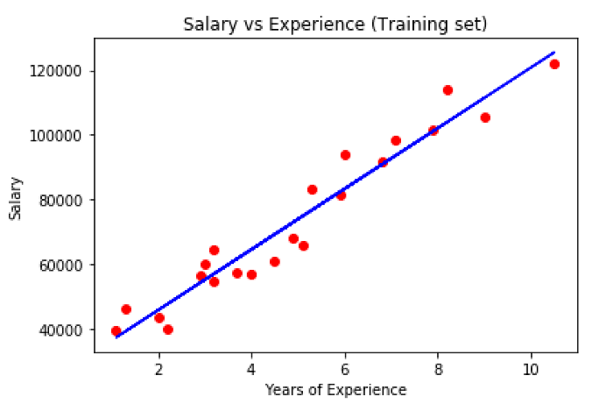
Ordinary Least Squares(OLS):
So our regression value m(theta1)=9449.96232 and b(theta0)=25792.2002.So ŷ = 9449.96232X + 25792.2002 this is our regression line.

Slide 52
Gradient Descent:
It is an efficient function to find out the min .values of J(theta0,theta1).
This method is not only used in linear regression but it is also employed in other machine learning algorithms.
First , the process is started with some random values of theta0, theta1 and the values of theta0 and theta1 will be changed to reduce J(theta0,theta1).
This step is done repeatedly until we end to the min . Value.
If we start at a point , the gradient – descent algorithm will take small steps in order to find the local minimum.
This is an important property of gradient descent .
If we start at a different point , it may find out a different local minimum.

Slide 53
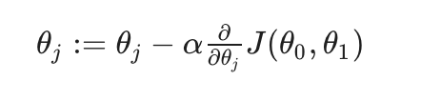
Gradient Descent:
Following is an equation of gradient descent algorithm ,

Slide 54
Gradient Descent:
J = 0,1 -> It denotes the feature index number.
Alpha-> Learning rate.
Next alpha->Partial derivative of theta j.
At each iteration j , one should simultaneously update the parameters theta_1, theta_2 ,…., theta_n.
This parameter should be updated properly in order to get the correct implementation of the gradient descent.

Slide 55
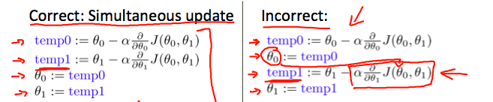
Gradient Descent:

Slide 56
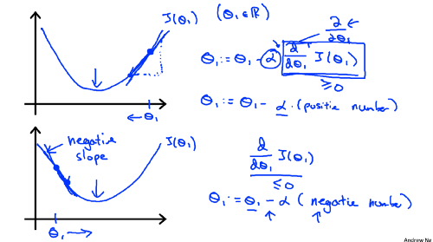
Gradient Descent:

Slide 57
Gradient Descent:
Consider the partial derivative term and theta1.
J(theta1) is nothing but the slope of that point theta1.
This derivative term is used to find the slope of thetaj(j =0,1).

Slide 58
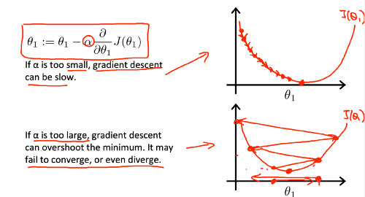
Gradient Descent:

Slide 59
Gradient Descent:
If the learning rate is too small, then gradient descent will take small steps and it will take more time to find a min value.
If the learning rate is too large , it will take a huge step and if the value is near to minimum but the learning rate is too high , it will fail to converge or even diverge.

Slide 60
Multiple Linear Regression:
It uses several explanatory variables in order to predict the outcome of a response variable.
It uses several explanatory variables in order to predict the outcome of a response variable.
The main aim of the multiple linear regression model is to model the relationship between the independent variable and the response variable.
Multiple linear regression is an extension of OLS regression because it involves more than one explanatory variable.
MLR uses several explanatory variables in order to predict the outcome of a response variable.
It is used in econometrics and financial inference.

Slide 61
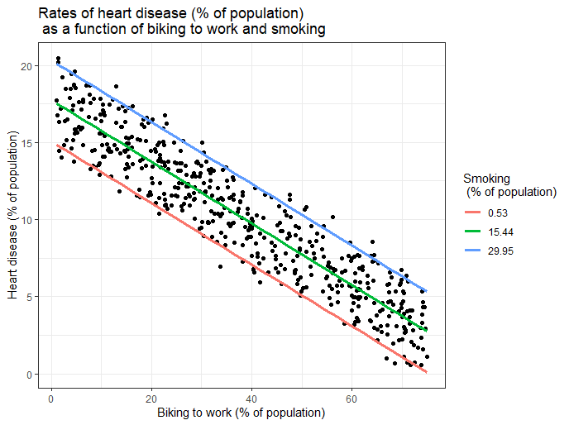
Multiple Linear Regression:

Slide 62
Why Multiple Linear Regression:(MLR)
This type of algorithm is useful in such situations when the number of variables is small.
This algorithm is used in finding the correlation between the dependent and independent variables.

Slide 63
Multiple Linear Regression(MLR):
y = m1.x + m2.z+ c
y is the dependent variable, that is, the variable that needs to be predicted. x is the first independent variable. It is the first input.
m1 is the slope of x1. It lets us know the angle of the line (x). z is the second independent variable. It is the second input. m2 is the slope of z. It helps us to know the angle of the line (z). c is the intercept. A constant that finds the value of y when x and z are 0.

Slide 64
Steps Of Multivariate Regression Analysis:
Feature Selection:
It is an important step in multivariate regression.
This step is essential in order to pick important features for model building.
Normalizing Features:
The features should be scaled as it maintains general distribution and ratios in the data.
Loss Function Selection and Hypothesis:
The loss function predicts if there is an error.
Hypothesis is the predicted value from the feature.

Slide 65
Steps Of Multivariate Regression Analysis:
Minimize the loss function:
The loss function should be minimized using a loss minimization algorithm on the dataset.
Gradient descent is one of the commonly used algorithms for loss minimization.
Test the Hypothesis function:
The hypothesis function should be checked as it is predicting values.

Slide 66
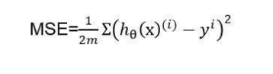
Cost Function:
It is nothing but the sum of the square of the difference between the predicted value and the actual value divided by twice the length of the dataset.

Slide 67
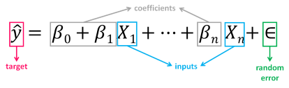
Multiple Linear Regression (MLR):
It is a form of linear regression used when there are two or more predictor or independent variables.
It includes some additional predictors.

Slide 68
Multiple Linear Regression (MLR):
The above equation is an extension of simple linear regression one.
Here , each input has the corresponding slope coefficient (ß).
ß0 is the intercept constant and is the value of y in the absence of all predictors(when all x terms are zero).
As the number of features grow , the complexity of the model increases.
It becomes more difficult to visualize our data.
As there are more parameters in these models , we should be more careful while working with them.
If we add more terms , it will improve the fit to the data.
This is dangerous because it leads to a model that fits the data but doesn’t mean anything useful.

Slide 69
Example:
The advertising dataset consists of a sales of a product in 200 different markets .
It contains advertising budgets for three different media : TV , radio and newspaper.
Dataset is used to predict the amount of sales(dependent variable) based on TV , radio and newspaper advertising budgets(independent variables).
The formula is:

Slide 70
Example:
The ß values are found in order to find the error function and fit the best line or hyperplane(depending on the number of input variables).
Load The Data and Describe the Data:
Import the required libraries:
import pandas as pd
import numpy as np
import seaborn as sns
import matplotlib.pyplot as plt
from sklearn.model_selection
import train_test_split
from sklearn.linear_model
import LinearRegression
from sklearn import metrics
from sklearn.metrics import r2_score
import statsmodels.api as sm

Slide 71
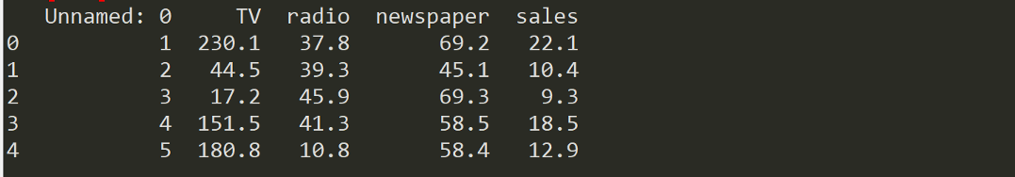
Example:
Load the Dataset:
df = pd.read_csv(“Advertising.csv”)
Understand the Dataset and Describe it:
df.head()

Slide 72
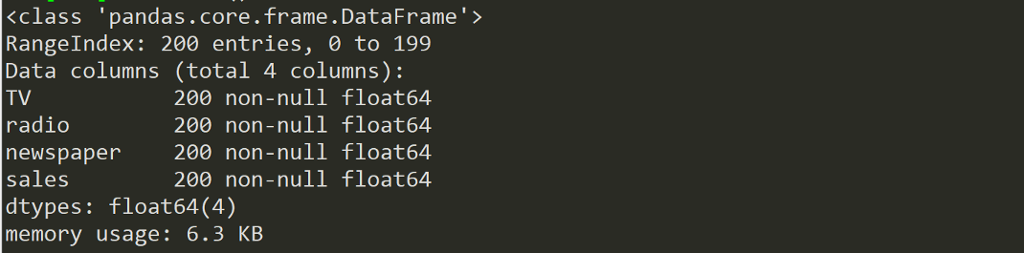
Example:
Drop the first column unnamed since we don’t need them:
df = df.drop([‘Unnamed: 0’], axis=1)
df.info()

Slide 73
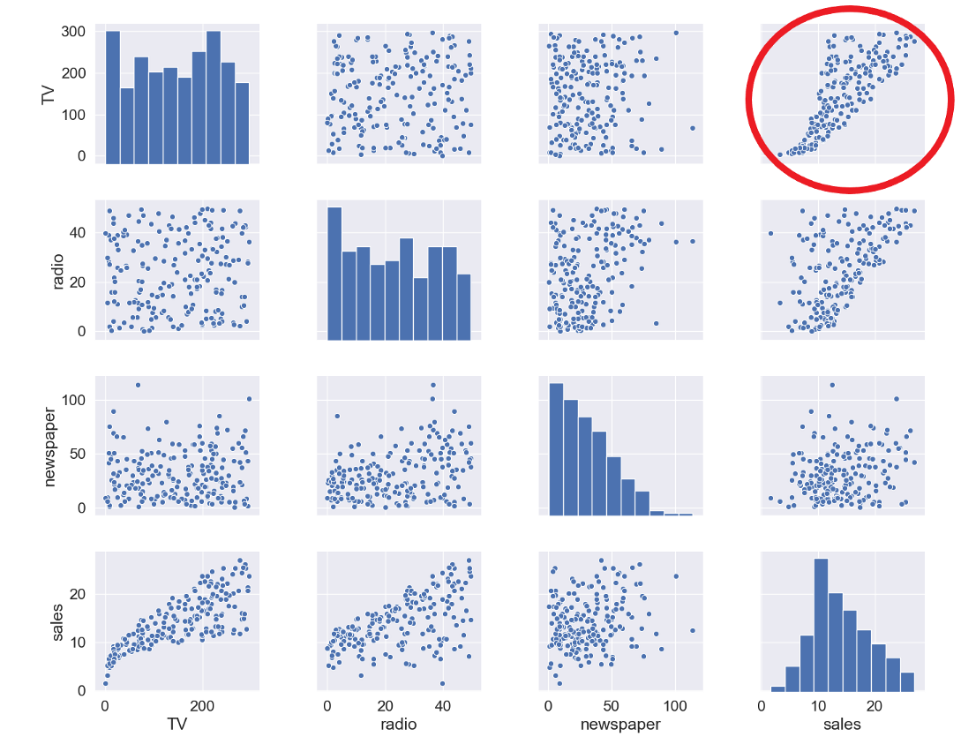
Example:
Dataset contains four columns , 200 registers and no missing values.
Visualize the relationship between independent and target variables.
sns.pairplot(df)

Slide 74
Example:
The relationship between TV and sales is very strong .
There is some trend between radio and sales , the relationship between newspaper and sales is non-existent.
It can be verified numerically through a correlation map.
mask = np.tril(df.corr())
sns.heatmap(df.corr(), fmt=’.1g’, annot=True, cmap= ‘cool’, mask=mask)

Slide 75
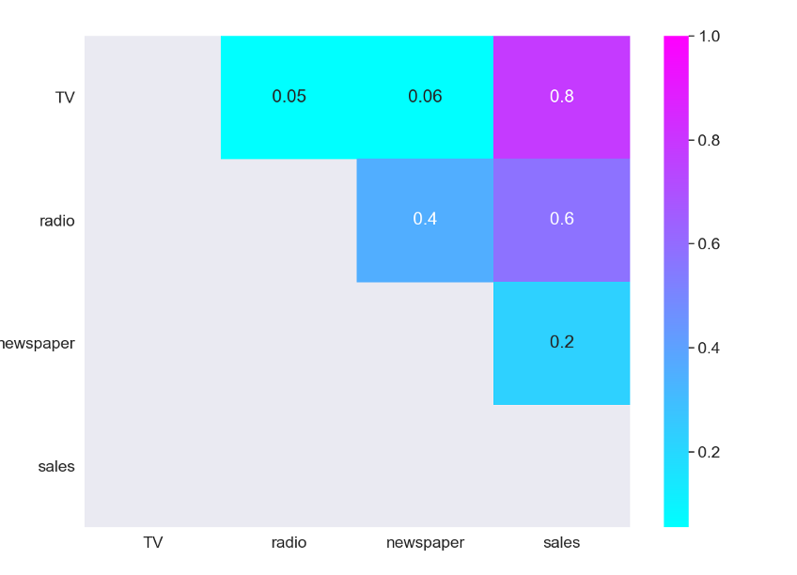
Output:

Slide 76
Example:
The strongest positive correlation happens between sales and TV .
The relationship between sales and newspaper is close to 0.
Select Features and Target Variable:
Divide the variables into two sets: dependent(or target variable “y”) and
Independent(or feature variable “X”).
X = df.drop([‘sales’], axis=1)
y = df[‘sales’]

Slide 77
Example:
Split the Dataset:
For understanding the model performance , the dataset is divided into training set and the testing set.
By splitting the dataset into two separate sets , we can train the model using one set and test the performance of the model using unseen data on the other one.
X_train, X_test, y_train, y_test = train_test_split(X, y, test_size=0.3, random_state=0)
The dataset is splitted into 70%train and 30%test.
The random_state parameter is used for initializing the internal random number generator.
If the random state is set to 0 . We can compare the output over multiple runs of the code using the same parameter.

Slide 78
Example:
print(X_train.shape,y_train.shape,X_test.shape,y_test.shape)
From the output , we can observe the following:
2 datasets of 140 registers each, one with 3 independent variables and one with the target variable.
It will be used for training and producing the linear regression model.
2 datasets of 60 registers each , one with 3 independent variables and one with the target variable , that will be used for testing the performance of the linear regression model.

Slide 79
Build Model:
mlr = LinearRegression()
Train the Model:
The training data is fitted to the model and it denotes the training part of the modelling process.
After it is trained , the model can be used to make predictions.
mlr.fit(X_train, y_train)
mlr.intercept_

Slide 80
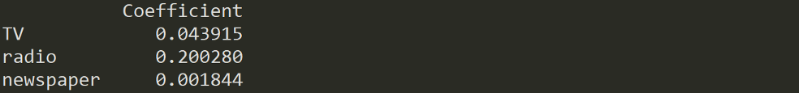
Example:
Print the values of the coefficients ß:
coeff_df = pd.DataFrame(mlr.coef_, X.columns, columns =[‘Coefficient’]) coeff_df.

Slide 81
Example:
Sales value can be estimated based on different budget values of “TV” , “radio” and “newspaper”.

Slide 82
Example:
For example, if we determine a budget value of 50 for TV, 30 for radio and 10 for newspaper, the estimated value of “sales” will be:
example = [50, 30, 10]
output = mlr.intercept_ + sum(example*mlr.coef_)
output

Slide 83
Test Model:
A test dataset is a dataset that is independent of the training dataset:
This test dataset is the unseen data set for your model which will help you have a better view of its ability to generalize:
y_pred = mlr.predict(X_test)

Slide 84
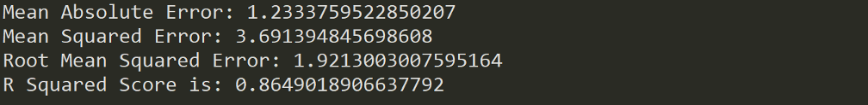
Evaluate Performance:
The quality of the model is estimated on how well the predictions match up against the actual values of the testing dataset:
print(‘Mean Absolute Error:’, metrics.mean_absolute_error(y_test, y_pred)) print(‘Mean Squared Error:’, metrics.mean_squared_error(y_test, y_pred)) print(‘Root Mean Squared Error:’, np.sqrt(metrics.mean_squared_error(y_test, y_pred)))
print(‘R Squared Score is:’, r2_score(y_test, y_pred))

Slide 85
Advantages and Disadvantages:
This type of algorithmm help us to find the relationship between the various variables present in the dataset.
It helps us in understanding the relation between the independent and the dependent variables.

Slide 86
Disadvantages:
They are a bit complex and require high levels of mathematical calculation.
It is not easy to interpret .
It contains some loss and error output which are not identical.
They are not suitable for small datasets . They can be applied only on larger datasets.

Slide 87
Limitations:
Mismeasurement: Factors might not be measured correctly.
For example , aptitude is difficult to measure and there are well known problems with IQ tests.
As a result , regression using IQ might not properly control for aptitude.
Too limited a focus:
A regression coefficient provides information about only about how small changes in one variable relate to changes in other variable.
For eg , it will show how a small change in education will affect the earnings but it will not allow the researcher to generalize about the effect of large changes.

Slide 88
Multiple Linear Regression:
Simple linear regression function allow us to make predictions about one variable based on the information that is available about the other variable.
Linear regression algorithm can only be used when one has two continuous variables – an independent variable and a dependent variable.
The independent variable is the parameter that is used to calculate the dependent variable.
A multiple linear regression model can be extended to several explanatory variables.

Slide 89
Multiple Linear Regression:
There is a linear relationship between the dependent variable and the independent variable.
The independent variables are not highly correlated with each other.
Yi observations are selected independently and randomly from the population.
Residuals should be normally distributed with a mean of 0 and a variance of sigma.
The coefficient of determination(R – Squared) – It is a statistical metric and it is used to measure how much of the variation in the outcome can be explained by the variation in the independent variables.

Slide 90
Multiple Linear Regression:
R^2 itself cannot be used to identify which predictors should be included in the model and which should be excluded.
R^2 value can only vary between 0 and 1.
The value 0 indicates that the value cannot be predicted by any of the independent variables.
The value 1 indicates that the outcome can be predicted without error from the independent variables.
When we interpret the results of multiple regression , beta coefficients are valid while holding all other variables constant.
The output from a multiple regression can be displayed horizontally as an equation or it can be displayed vertically in a table form.

Slide 91
How to Use Multiple Linear Regression:
An analyst wants to know how the movement of market affects the price of ExxonMobil(XOM).
The linear equation will have the value of S and P.
500 index as the independent variable or predictor and the price of XOM as the dependent variable.
There are various factors that affect the outcome of an event.
The price movement of ExxonMobil , depends on just the performance of the overall market.

Slide 92
How to Use Multiple Linear Regression?
There are other predictors such as price of oil , interest rates and the price movement of oil can affect the price of XOM.
They also affect the stock prices of other oil companies.
In order to understand the relationship when two or more variables are present , multiple linear regression is used.

Slide 93
How to Use Multiple Linear Regression?
Multiple Linear Regression(MLR) is used to establish a mathematical relationship between several random variables.
This algorithm examines how multiple indepenedent variables are related to one dependent variable.
Once each of the independent factors has been determined to predict the dependent variable , the information on multiple variables can be used to create an accurate prediction on the level of effect they have on the outcome variable.
The model creates a relationship in the form of a straight line that best approximates all the individual data points.

Slide 94
How to Use Multiple Linear Regression?
When we see the Multiple Linear Regression(MLR) equation above , we can see that:
Yi = dependent variable – the price of XOM.
Xi1 = interest rates.
Xi2 = oil price.
Xi3 = value of S and P 500 index.
Xi4 = price of oil features.
B0 = y-intercept at time 0.
B1 = Regression coefficient . It measures the unit change in the dependent variable.
When xi1 changes , the change in XOM price when interest rates changes.

Slide 95
How to Use Multiple Linear Regression?
B2 – coefficient value that measures a unit change in the dependent variable when xi2 changes – the change in XOM price when oil prices changes.
The least squares estimates – B0,B1,B2 … Bp . These values are usually computed by statistical software.
Many different variables can be included in a regression model.
Each independent variable is differentiated with a number – 1,2,3,4,…p.
Multiple Regression model allows an analyst to predict an income based on the information provided on multiple explanatory variables.

Slide 96
How to Use Multiple Linear Regression?
Model is not perfectly accurate as each data point can differ slightly from the outcome predicted by the model.
The residual error , e is the difference between the actual outcome and the predicted outcome.
It is included in the model to account for such slight variations.
If the price of other variables are held constant , then the price of XOM will increase by 7.8% if the price of oil in the markets increases by 1%.
The model also shows that the price of XOM will decrease by 1.5% following a 1% rise in the interest rates.

Slide 97
How to Use Multiple Linear Regression?
R^2 indicates that 86.5% of the variations in the stock price of Exxon Mobil can be explained by changes in the interest rate, oil price , oil futures and S and P 500 index.

Slide 98
Difference Between Linear and Multiple Regression:
Ordinary Least squares (OLS) method compares the response of a dependent variable with respect to some change in some explanatory variables.
A dependent variable is rarely explained by only one variable.
An analyst uses multiple regression .
It attempts to explain a dependent variable using more than one independent variable.
Multiple regressions can be linear and nonlinear.
These regression algorithms are based on the assumption that there is a linear relationship between the dependent and the independent variables.

Slide 99
Difference Between Linear and Multiple Regression:
It is also based on the assumption that there is no correlation between the independent variables.

Slide 100
What makes Multiple Regression Multiple?
A multiple regression considers the effect of more than one explanatory variable on some outcome of interest.
It evaluates the relative effect of these independent variables on the dependent variable and it holds some other variables in the model as constants.

Slide 101
Advantages Of Multiple Regression Over Simple OLS Regression:
A dependent variable is rarely explained by only one variable.
In case of Multiple Linear Regression , it attempts to explain a dependent variable by more than one independent variable.
The model assumes that there are no major correlations between the independent variables.
Multiple Regression models are complex .
It becomes even more complex when more variables are included in the model or when the size of the data grows.
To run multiple regression , we need to use specialized software functions within programs like Excel.

Slide 102
How We Can Make Multiple Regressions To Be Linear:
Multiple Linear Regression model calculates the best fit line .
It minimizes the variances of each of the variables included as it relates to the dependent variable.
As it fits a line , it is considered as a linear model.
There are other non-linear regression models and it involves multiple variables , such as logistic Regression , quadratic Regression and probit models.

Slide 103
Application Of Multiple Linear Regression Models In Finance:
Any econometric model that looks at more than one variable is considered as multiple.
Factor models compare two or more factors to analyze the relationships between the variables and the resulting performance.

Slide 104
Limitations:
Omitted Variables:
It is necessary to have a good theoretical model to suggest variables that explain the dependent variable.
Various factors should be considered to explain the dependent variable while dealing with two-variable regression.
Reverse Causality:
Many theoretical models predict bidirectional causality – a dependent variable can cause changes in one or more explanatory variables.
For instance , higher earnings may enable people to invest more in their education which in turn raises their earnings.

Slide 105


